Slide 1
Exploratory Data Analysis
Examining Relations

Slide 2
Examining Relationships Overview
So far we have dealt with data obtained from one variable (either categorical or quantitative), and learned how to describe the distribution of the variable using the appropriate visual displays and numerical measures. In this section, examining relationships, we will look at two variables at a time and, as the title suggests, explore the relationship between them using (as before) visual displays and numerical summaries

Slide 3
Exploring Two Variables: Explanatory and Response
In most studies involving two variables, each of the variables has a role. We distinguish between:
the explanatory variable (also commonly referred to as the independent variable)-—the variable that claims to explain, predict or affect the response
the response variable (also commonly referred to as the dependent variable)-—the outcome of the study.
Typically the explanatory (or independent) variable is denoted by X, while the response (or dependent) variable is denoted by Y.

Slide 4
Many Students Wonder ...
Question: Is the role classification of variables always clear? In other words, is it always clear which of the variables is the explanatory and which is the response?
Answer: No. There are studies in which the role classification is not really clear. This mainly happens in cases when both variables are categorical or both are quantitative. An example is a study that explores the relationship between students' SAT Math and SAT Verbal scores. In cases like this, any classification choice would be fine (as long as it is consistent throughout the analysis).

Slide 5
The Role-Type Classification
If we further classify each of the two relevant variables according to type (categorical or quantitative), we get the following 4 possibilities for "role-type classification"
Categorical explanatory and quantitative response
Categorical explanatory and categorical response
Quantitative explanatory and quantitative response
Quantitative explanatory and categorical response

Slide 6
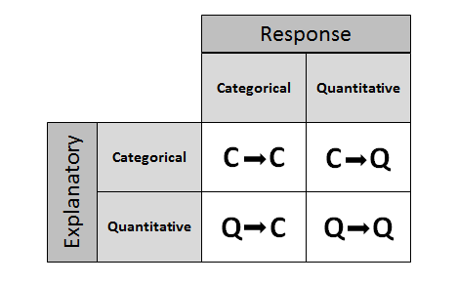
In each of the 4 cases, different statistical tools (displays and numerical measures) should be used in order to explore the relationship between the two variables.

Slide 7
Examples
Gender is the explanatory variable and it is categorical.
Test score is the response variable and it is quantitative.
Therefore this is an example of case C→Q.
Light Type is the explanatory variable and it is categorical.
Nearsightedness is the response variable and it is categorical.
Therefore this is an example of case C→C.
SAT Score is the explanatory variable and it is quantitative.
GPA of Freshman Year is the response variable and it is quantitative.
Therefore this is an example of case Q→Q.
Time is the explanatory variable and it is quantitative.
Driving Test Outcome is the response variable and it is categorical.
Therefore this is an example of case Q→C.

Slide 8
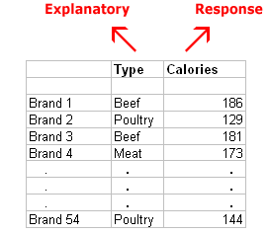
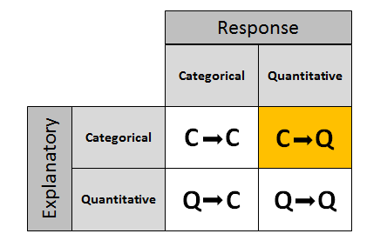
Case C→Q: Introduction (Raw data)
Notes:
Background: People who are concerned about their health may prefer hot dogs that are low in calories. A study was conducted by a concerned health group in which 54 major hot dog brands were examined, and their calorie contents recorded. In addition, each brand was classified by type: beef, poultry, and meat (mostly pork and beef, but up to 15% poultry meat). The purpose of the study was to examine whether the number of calories a hot dog has is related to (or affected by) its type. (Reference: Moore, David S., and George P. McCabe (1989). Introduction to the Practice of Statistics. Original source:Consumer Reports, June 1986, pp. 366-367.)
Answering this question requires us to examine the relationship between the categorical variable, Type and the quantitative variable Calories. Because the question of interest is whether the type of hot dog affects calorie content,
the explanatory variable is Type, and
the response variable is Calories.

Slide 9
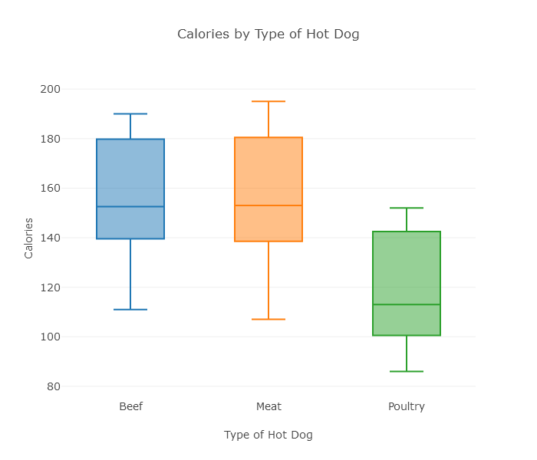
side-by-side boxplots: compare the distribution of calorie counts in hot dog type

Slide 10
descriptive statistics
Statistic | Beef | Meat | Poultry
min | 111 | 107 | 86
Q1 | 139.5 | 138.5 | 100.5
Median | 152.5 | 153 | 113
Q3 | 179.75 | 180.5 | 142.5
Max | 190 | 195 | 152
Notes:
What we learn from this example is that when exploring the relationship between a categorical explanatory variable and a quantitative response (Case C→Q), we essentially compare the distributions of the quantitative response for each category of the explanatory variable using side-by-side boxplots supplemented by descriptive statistics.

Slide 11
Let's Summarize!
The relationship between a categorical explanatory variable and a quantitative response variable is summarized using:
Data display: side-by-side boxplots
Numerical summaries: descriptive statistics

Slide 12
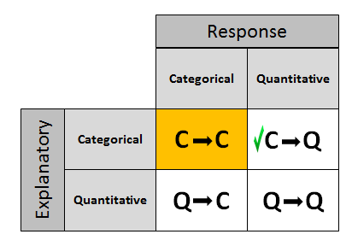
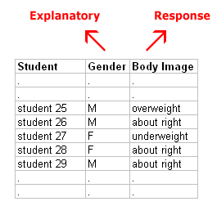
Case C→C: Two-Way Tables (Raw data)
Notes:
Answering these questions requires us to examine the relationship between two categorical variables, gender and body image. Because the question of interest is whether there is a gender effect on body image,
the explanatory variable is gender, and
the response variable is body image.

Slide 13
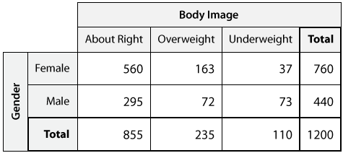
In order to summarize the relationship between two categorical variables, we create a display called a two-way table.
Notes:
The table has the possible genders in the rows, and the possible responses regarding body image in the columns. At each intersection between row and column, we put the counts for how many times that combination of gender and body image occurred in the data. We sum across the rows to fill in the Total column, and we sum across the columns to fill in the Total row.

Slide 14
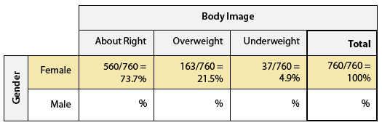
Case C→C: Conditional Percent
To make the sense of raw data , we will make the two-way table, with some numerical summaries to compare the distributions.
These numerical summaries are found by converting the counts to (conditional) percentages within that gender.
Notes:
These numerical summaries are called conditional percentages, since we find them by "conditioning" on one of the genders.

Slide 15
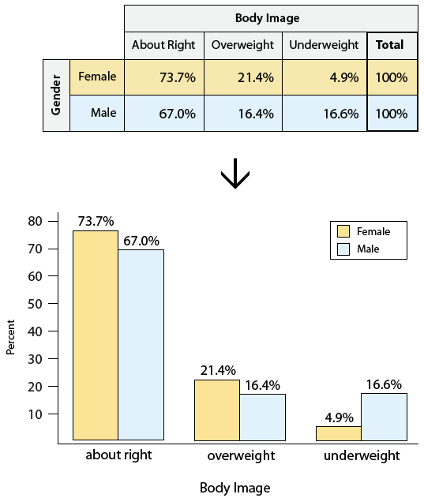
Another way to visualize the conditional percentages, instead of in a table, is to use a double bar chart. This display is quite common in newspapers

Slide 16
Let's Summarize!
The relationship between two categorical variables is summarized using:
Data display: two-way table, supplemented by
Numerical summaries: conditional percentages.
Notes:
Conditional percentages are calculated for each value of the explanatory variable separately. They can be row percents, if the explanatory variable "sits" in the rows, or column percents, if the explanatory variable "sits" in the columns.
When we try to understand the relationship between two categorical variables, we compare the distributions of the response variable for values of the explanatory variable. In particular, we look at how the pattern of conditional percentages differs between the values of the explanatory variable.

Slide 17
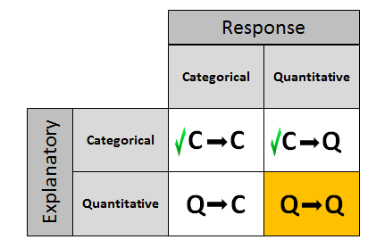
Case Q→Q: Two Quantitative Variables
We are done with cases C→Q and C→C, and now we will move on to case Q→Q, where we examine the relationship between two quantitative variables.

Slide 18
Overview
Case
In case C→Q we compared distributions of the quantitative response.
Case
In case C→C we compared distributions of the categorical response.
Case
Case Q→Q is different in the sense that both variables (in particular the explanatory variable) are quantitative, and therefore, as you'll discover, this case will require a different kind of treatment and tools.

Slide 19
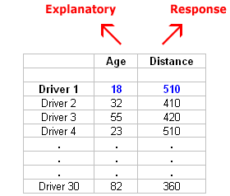
Example Study: To explore the effect of age on maximum legibility distance. The explanatory variable is Age, and The response variable is Distance.
30 pairs of values

Slide 20
Scatterplot: Introduction
Scatterplot is the appropriate graphical display for examining the relationship between two quantitative variables.
To create a scatterplot, each pair of values is plotted, so that the value of the explanatory variable (X) is plotted on the horizontal axis, and the value of the response variable (Y) is plotted on the vertical axis.

Slide 21
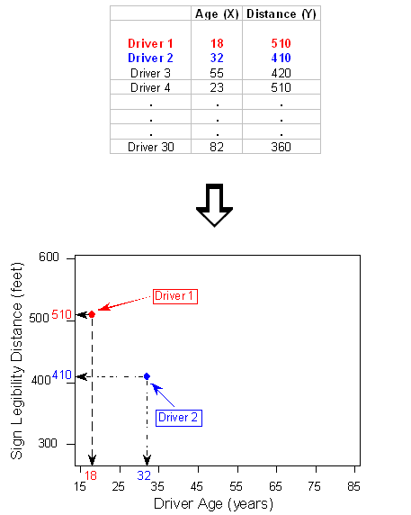

Slide 22
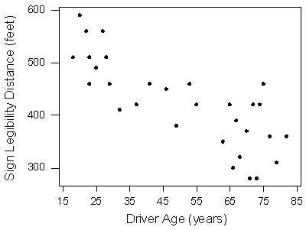
Completed Example Scatterplot

Slide 23
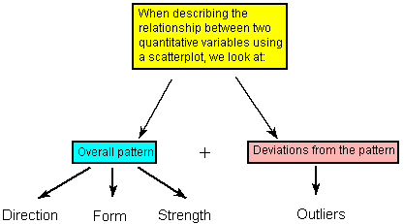
Interpreting the Scatterplot

Slide 24
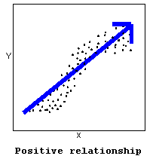
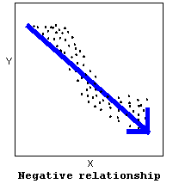
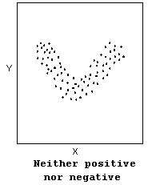
The direction of the relationship can be positive, negative, or neither

Slide 25
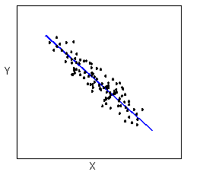
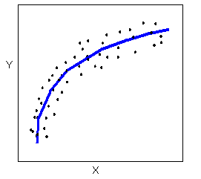
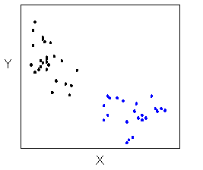
The form of the relationship is its general shape.
Linear
Curvilinear
Clusters

Slide 26
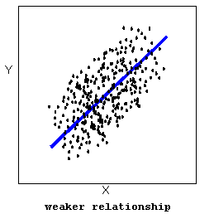
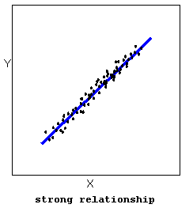
The strength of the relationship is determined by how closely the data follow the form of the relationship.

Slide 27
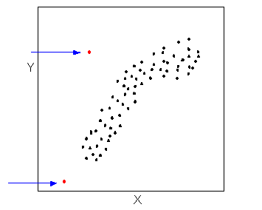
Data points that deviate from the pattern of the relationship are called outliers.

Slide 28
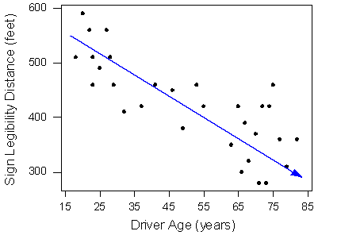
Interpretation of Example Scatterplot
The direction of the relationship is negative.
The form of the relationship seems to be linear.
The relationship appears to be moderately strong.
All the data points seem to "obey" the pattern—there do not appear to be any outliers.

Slide 29
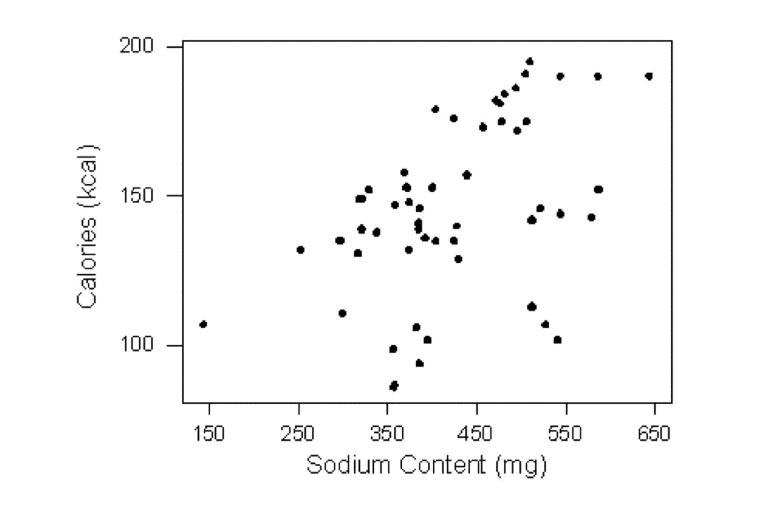
Labeled Scatterplot

Slide 30
Linear Relationships: Introduction
We will restrict our attention to the special case of relationships that have a linear form, since they are quite common and relatively simple to detect.
More importantly, there exists a numerical measure that assesses the strength of the linear relationship between two quantitative variables with which we can supplement the scatterplot.

Slide 31
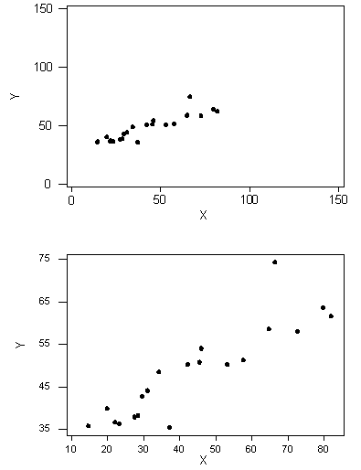
Need for Numerical Measure: Which of the two scatterplots do you think displays a stronger linear relationship?
Notes:
We can see that in both cases, the direction of the relationship is positive and the form of the relationship is linear. What about the strength?
The purpose of this example was to illustrate how assessing the strength of the linear relationship from a scatterplot alone is problematic, since our judgment might be affected by the scale on which the values are plotted. This example, therefore, provides a motivation for the need to supplement the scatterplot with a numerical measure that will measure the strength of the linear relationship between two quantitative variables.

Slide 32
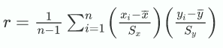
Linear Relationships: Correlation
The Correlation Coefficient—r
The numerical measure that assesses the strength of a linear relationship is called the correlation coefficient, and is denoted by r.
Definition: The correlation coefficient (r) is a numerical measure that measures the strength and direction of a linear relationship between two quantitative variables.
Calculation: r is calculated using the following formula:

Slide 33
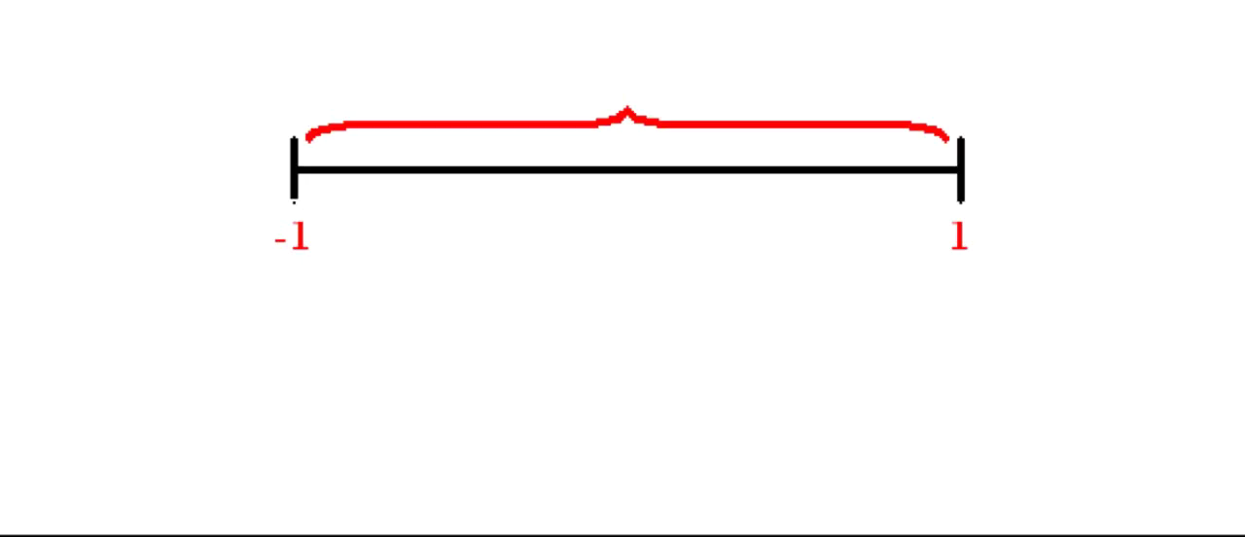
Linear Relationships: Correlation

Slide 34
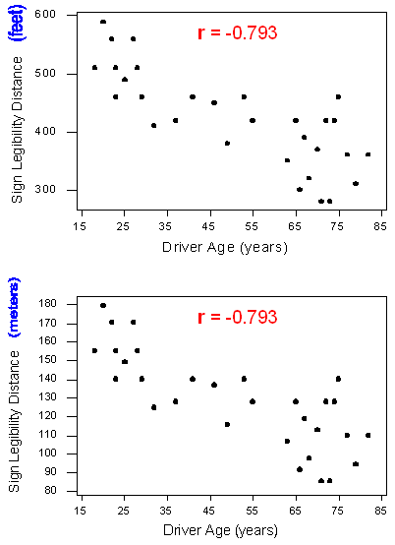
Linear Relationships: Properties of r
1. Change in the units of measurement of the explanatory variable and/or the response variable has no effect on the correlation (r).

Slide 35
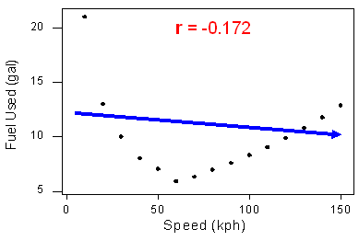
2. The correlation measures only the strength of a linear relationship between two variables. It ignores any other type of relationship, no matter how strong it is.
Linear Relationships: Properties of r

Slide 36
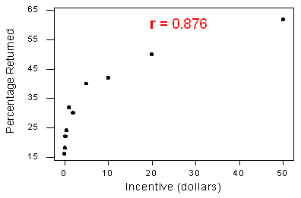
3. The correlation by itself is not sufficient to determine whether a relationship is linear.
The relationship is curvilinear, yet the correlation r = 0.876 is quite close to 1.
Linear Relationships: Properties of r

Slide 37
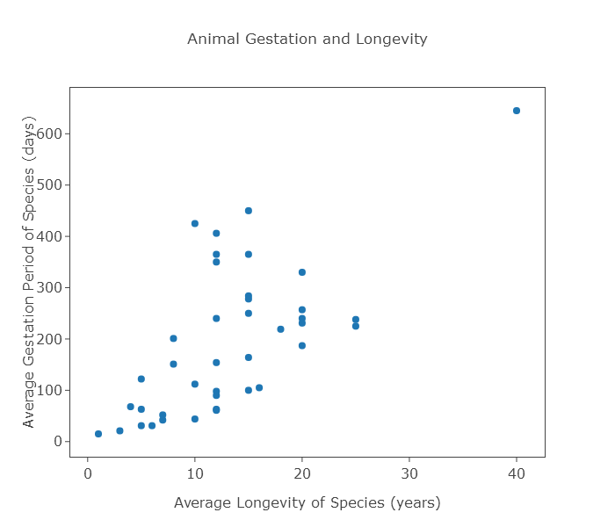
4. The correlation is heavily influenced by outliers. Example: What do you think will happen to the correlation (0.663) if we remove this outlier?
Linear Relationships: Properties of r

Slide 38
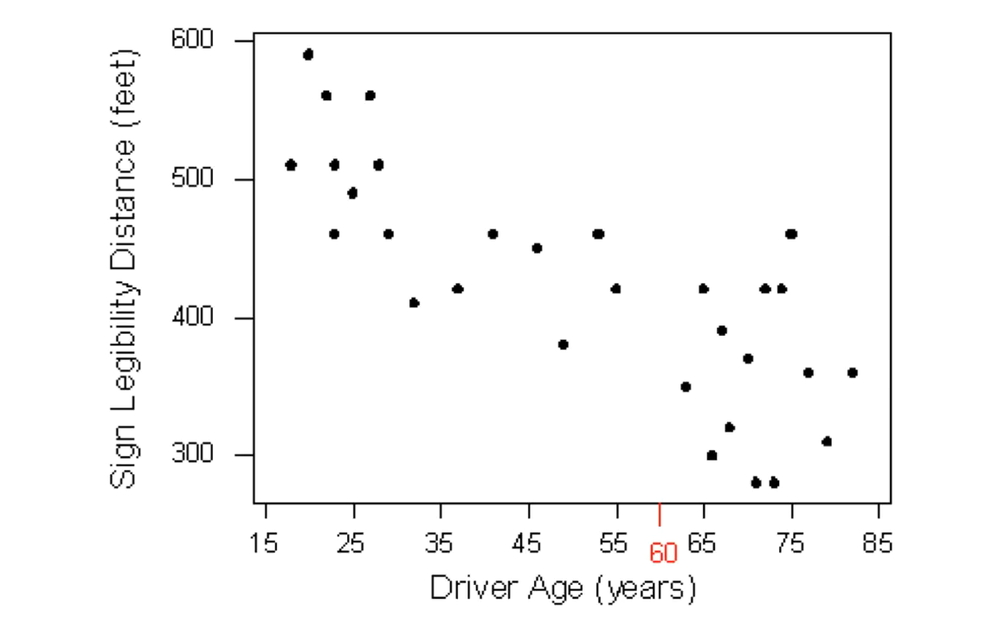
Linear Relationships: Regression
Summarizing the Pattern of the Data with a Line
Correlation only measures the strength and direction
Regression describes more precisely how one variable changes with the other or predict the value of the response variable for a given value of the explanatory variable

Slide 39
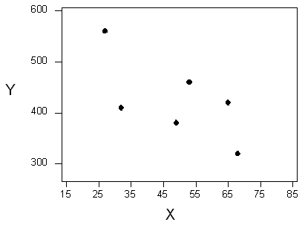
Linear Regression
The technique that specifies the dependence of the response variable on the explanatory variable is called regression. When that dependence is linear, the technique is called linear regression.
To understand how such a line is chosen, consider this very simplified version of the age-distance example (we left just 6 of the drivers on the scatterplot).

Slide 40
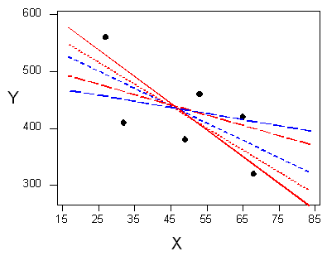
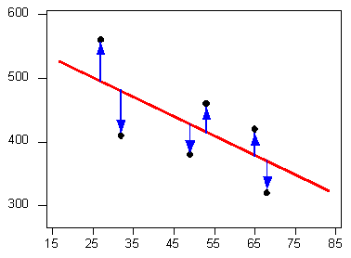
There are many lines that look like they would be good candidates to be the line that best fits the data. But we want the line we choose to be close to the data points. In other words, whatever criterion we choose, it had better somehow take into account the vertical deviations of the data points from the line, which are marked with blue arrows in the plot above.

Slide 41
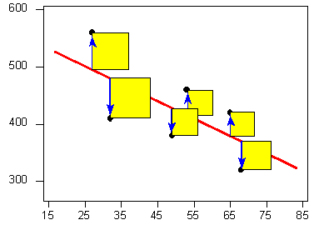
Least Squares Regression: Among all the lines that look good on your data, choose the one that has the smallest sum of squared vertical deviations. This line is called the least-squares regression line.

Slide 42
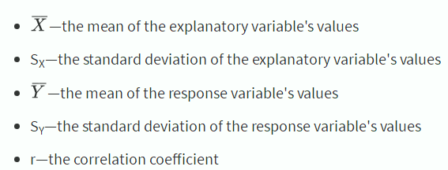
Linear Relationships: Least Squares Regression
Like any other line, the equation of the least-squares regression line for summarizing the linear relationship between the response variable (Y) and the explanatory variable (X) has the form:
Y = a + bX
All we need to do is calculate the intercept a, and the slope b, which is easily done if we know:

Slide 43
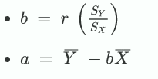
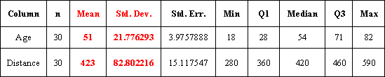
EXAMPLE: AGE-DISTANCE Let's revisit our age-distance example, and find the least-squares regression line.
Formula:
Dependent Variable: Distance
Independent Variable: Age
R (correlation coefficient)= -0.7929
Slope: b = −0.793 ∗ 82.821.78 = −3
Intercept : a = 423 - (-3 * 51) = 576
Least squares regression line :
Distance = 576 + (- 3 * Age)
Notes:
This means that for every 1-unit increase of the explanatory variable, there is, on average, a 3-unit decrease in the response variable. The interpretation in context of the slope being -3 is, therefore: For every year a driver gets older, the maximum distance at which he/she can read a sign decreases, on average, by 3 feet.

Slide 44
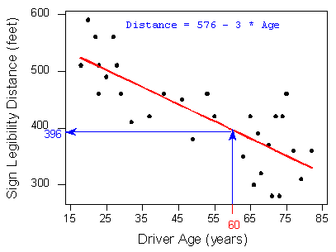
Linear Relationships: Prediction
Predict the maximum distance at which a sign is legible for a 60-year-old:
Predicted distance = 576 + (- 3 * 60) = 396
Hence, 396 feet is our best prediction for the maximum distance at which a sign is legible for a 60-year-old.

Slide 45
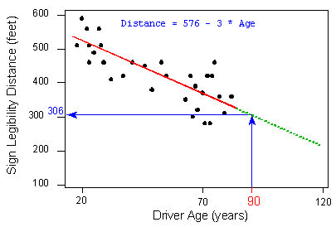
Linear Relationships: Extrapolation
Prediction for ranges of the explanatory variable that are not in the data is called extrapolation.
Extrapolation can lead to very poor or illogical predictions.

Slide 46
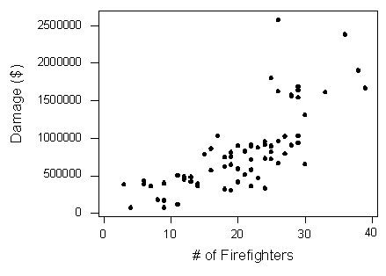
Causation and Lurking Variables: Impact on X and Y
The scatterplot clearly displays a fairly strong (slightly curved) positive relationship between the two variables.
Does sending more fier fighters cause more damage?

Slide 47
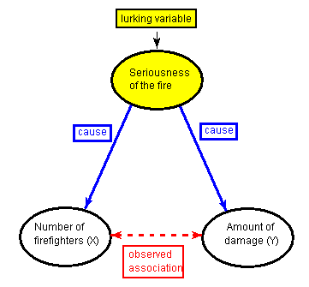
Lurking variable: There is a third variable in the background—the seriousness of the fire—that is responsible for the observed relationship, called Lurking variable. A lurking variable is a variable that is not among the explanatory or response variables in a study, but could substantially affect your interpretation of the relationship among those variables.

Slide 48
Causation
In particular, as in our example, the lurking variable might have an effect on both the explanatory and the response variables. This common effect creates the observed association between the explanatory and response variables, even though there is no causal link between them. This possibility, that there might be a lurking variable (which we might not be thinking about) that is responsible for the observed relationship leads to our principle:
Principle:
Association does not imply causation!

